Slide 1
NJ Center for Tourette Syndrome & Associated Disorders, Inc.
Collaborative Partnerships for the Tourette Syndrome Community
Established in 2004 as the nation’s first
Center of Excellence for Tourette Syndrome
February 8, 2016

Slide 2
Tourette Syndrome Quick Facts
Tourette Syndrome (TS) is an inherited neurobiological spectrum disorder characterized by the
childhood onset of uncontrollable vocal and physical tics.
Tics can include head jerking, eye blinking, facial grimaces, jumping, spinning, sniffing, throat clearing, squealing, barking and more.
Vocal tics can also include echolalia (involuntary repetition of what someone else has just said), the involuntary repetition of ones own words and the most infamous and problematic vocal tic: coprolalia, which is the involuntary utterance of curse words, ethnic or racial slurs. (This symptom is present in only 5 percent of cases.)
Tourette Syndrome:
Often appears when a child is 6 or 7 years old
Affects every race and ethnic group
Boys are affected 3 – 5 times more often than girls
Lifelong condition – course unknown – no cure
No standard treatment protocol
Average time from onset to diagnosis is more than 7 years
Psychological, social, educational, physical impact
Associated Disorders: Attention Deficit Disorder, Obsessive Compulsive Disorder, learning disabilities, panic attacks, depression, generalized anxiety disorder, sleep disorders
NJ Center for Tourette Syndrome & Associated Disorders, Inc.

Slide 3
Tourette Syndrome Quick Facts
Tourette Syndrome is:
Under-represented in medical texts
Misunderstood by the public and professionals
Underdiagnosed by the medical community
Misrepresented by the media
Misunderstood by educators
A spectrum disorder — severe to mild
It’s estimated that about 1 in 100 children and adults exhibit symptoms of TS. Kids and families with TS frequently report feelings of isolation from being ostracized or bullied.
NJ Center for Tourette Syndrome & Associated Disorders, Inc.

Slide 4
NJ Center for Tourette Syndrome
& Associated Disorders
“A recent CDC survey reveals TS is infrequent enough that most physicians, psychologists, social workers and educators do not have the opportunity to develop familiarity or expertise with it.
The same survey suggests that the disorder often goes unrecognized and under-diagnosed in minority children with less ready access to health care.
TS has a complex, often subtle range of manifestations that cut across professional disciplines, affecting mental health and social functioning (anxiety, depression, OCD), learning and school adaptation (vulnerability to ADHD, learning difficulties, stigmatization) and motor coordination as well as neurological functioning.
Treatment and educational planning involves special expertise and resources, often unavailable even in good primary care medical and mental health settings, to coordinate behavioral and family interventions, educational assessment and planning, school consultation and advocacy and to provide consultation to clinicians, parents and educators, as well as more traditional services such as pharmacotherapy and long-term case management.
With some patients, tics improve in young adulthood, but other features of the disorder – ADHD, OCD, anxiety proneness, uneven cognitive profile, impaired self esteem – persist into later life.”
— Robert King, MD Yale Child Study Center, Yale TS/OCD Clinic
NJ Center for Tourette Syndrome & Associated Disorders, Inc.

Slide 5
NJ Center for Tourette Syndrome
& Associated Disorders
Mission
The NJ Center for Tourette Syndrome & Associated Disorders, Inc. is a not-for-profit organization committed to the advocacy of children and families with Tourette Syndrome and its associated disorders. Dedicated to delivering high quality services to these individuals, the Center recognizes the importance of educating the public, medical professionals, and teachers about this disorder through programs and affiliations with public schools, health centers and universities.
To ensure that individuals with Tourette Syndrome are contributing members of their communities and society at large, the Center is committed to leading the promotion and development of diagnostic and treatment therapies and actively supporting research for a cure.
In 2004, NJCTS received funding from the state of New Jersey to create the nation’s first Center of Excellence for Tourette Syndrome and Associated Disorders to provide support for families, public outreach, awareness and education for the schools and medical communities and research into the cause and treatment of TS.
NJ Center for Tourette Syndrome & Associated Disorders, Inc.

Slide 7
NJ Center for Tourette Syndrome
& Associated Disorders
NJCTS Provides:
Referrals for medical diagnosis and treatment
Referrals for psychological services
Coordinated family support among partner and community organizations throughout the state
Education and training at medical schools and universities to develop a new generation of professionals knowledgeable about TS and associated disorders
Outreach to practicing physicians, educators, and allied professionals
Research into causes and effective treatments for TS and associated disorders
The nation’s only university-based, stand-alone TS psychological clinic, located at Rutgers University
The world’s first TS DNA and cell sharing repository, making genetic material available to qualified researchers world-wide to understand factors that may lead to treatments and cures
Federal Legislation to provide services and research opportunities that will ultimately assist individuals with TS and associated disorders
NJ Center for Tourette Syndrome & Associated Disorders, Inc.

Slide 8
NJ Center for Tourette Syndrome
& Associated Disorders
Statewide Outreach to Mental Health and Medical professionals provides research updates to physicians and family practitioners, webinars, and presentations at institutions statewide to develop a new generation of doctors and medical staff who are knowledgeable about TS and associated disorders.
NJCTS provides Patient-Centered Medical Education presentations and Grand Rounds at institutions statewide including:
Newark Beth Israel Medical Center
Morristown Medical Center
Yale University
Virtua Hospital
Goryeb Children’s Hospital
JFK Medical Center
Robert Wood Johnson University Hospital
Cooper University Hospital
Overlook Medical Center
Saint Barnabas Hospital
Capital Health Medical Center
Rutgers Medical School
Trinitas Hospital
Bergen Regional Medical Center
Monmouth Medical Center
Saint Peter’s University Hospital
Bristol-Myers Squibb Children’s Hospital
UMDNJ Newark
Children’s Specialized Hospital
UBHC Mental Health Professionals
Kennedy Memorial Hospital
St. Clare’s Hospital
UBHC Screeners
Jersey Shore Medical Center
CentraState Medical Center
NJ Center for Tourette Syndrome & Associated Disorders, Inc.

Slide 9
NJ Center for Tourette Syndrome
& Associated Disorders
Education outreach including faculty trainings, peer presentations, and workshops empower students and prepare teachers and administrators to best accommodate students with TS and associated disorders.
NJCTS provides presentations at the following institutions and organizations:
County College of Morris
Ocean County College
Kean University
Raritan Valley Community College
Bergen County Community College
Middlesex County Community College
Mercer County College
Monmouth University
Richard Stockton College
Passaic County Community College
Warren County College
Rutgers University
Camden County College
Ramapo College of New Jersey
Sussex County Community College
Brookdale Community College
Rowan University
Cumberland County College
Montclair State University
Rider University
New Jersey Education Association
New Jersey School Nurses Association
Latino Psychological Association
CSA Value Options
New Jersey Coalition for Inclusive Education
New Jersey Learning Disabilities Association
PerformCare
Council for Exceptional Children
National Association of Social Workers-New Jersey
New Jersey State School Nurses Association
NJ Center for Tourette Syndrome & Associated Disorders, Inc.

Slide 10
NJ Center for Tourette Syndrome
& Associated Disorders
A statewide network of hospital affiliated patient and family support groups:
• Morristown Memorial Hospital – Morristown • Atlantic City Medical Center – Pomona
• Valley Hospital – Ridgewood • Somerset Medical Center – Somerville
• JFK Hospital – Edison • Virtua Hospital – Voorhees
• Robert Wood Johnson Hospital – Hamilton • South Jersey Hospital – Vineland
• Jersey Shore Medical Center – Neptune • St. Clare’s Hospital – Denville
• Robert Wood Johnson Hospital – New Brunswick • Hunterdon Medical Center – Flemington
• University Hospital – Newark • Jersey City Medical Center – Jersey City
*Replaced by Webinars and Call-in Support Groups
New Jersey Center for Tourette Syndrome & Associated Disorders, Inc.

Slide 11
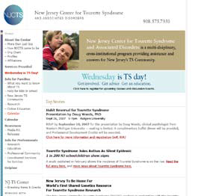
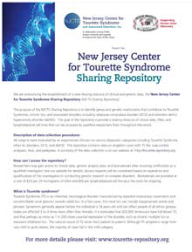
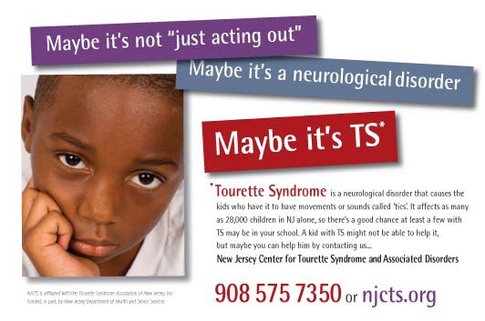
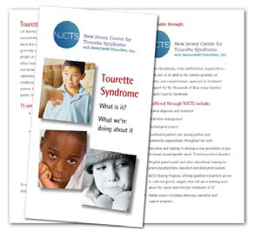
Fighting the Stigma of Tourette Syndrome
Statewide media campaign raising awareness, educating the public, identifying new cases and prompting action on the part of those who can help people with TS. Targeted paid announcements and donated PSA’s saturate the state- including important inner-city and Spanish-speaking areas where awareness of TS, recognition of its symptoms and resources for help are traditionally low.
NJ Center for Tourette Syndrome & Associated Disorders, Inc.

Slide 12
Fighting the Stigma of Tourette Syndrome
The GreaTS — Presented by Tim Howard, NJCTS, and BNO Creative Agency
The GreaTS is a global platform dedicated to breaking down social stigmas, creating awareness, and providing support resources around Tourette Syndrome. It is a call to arms for those with TS to rise above the challenges and embrace their greatness. Being a legendary goalkeeper isn’t the only thing that makes Tim Howard one of The GreaTS. He was diagnosed with Tourette Syndrome at age 10. But Tim never let it hold him back. And by speaking out, sharing his story, and getting involved every day, he’s making sure others in the TS community can rise above the challenges of TS, too. www.standwiththegreats.org
NJ Center for Tourette Syndrome & Associated Disorders, Inc.

Slide 13
Contact:
Faith W. Rice, Executive Director
NJ Center for Tourette Syndrome & Associated Disorders, Inc.
50 Division Street, Suite 205
Somerville, NJ 08876
908-575-7350
www.njcts.org
NJ Center for Tourette Syndrome & Associated Disorders, Inc.
Collaborative Partnerships for the Tourette Syndrome Community
Established in 2004 as the nation’s first
Center of Excellence for Tourette Syndrome

